Slide 1
Strategic Asset Management: Best Practices in Higher Education
Session 38
Presented by Bernard Mostert

Slide 2
DISCLAIMER
This presentation is only a summary of some of Adapt IT’s products, features and their latest developments. Adapt IT only intends for the information to give you an overview, and not a complete and comprehensive statement that necessarily suits your purposes.
Adapt IT reserves the right to change any information contained in this presentation and is not responsible for any loss that results from inaccuracies in the information. You may not distribute or reproduce the information without Adapt IT’s written permission.

Slide 3
Process flow - basic
Budget Process
Procurement Process
Process GRV
Process Payment
Record Asset
Tag Asset
Notes:
Let’s start with a basic flow of activities in the asset “cycle”.
There is a budget process – the budget is loaded and then
You can start with procurement – where the requests are completed, approvals are done, orders issued…
Once the goods are delivered you will process a GRV and tag the asset – or put a bar code on it.
The asset will be recorded in the register with all the details and since you have the invoice (when you received the goods) you will continue with the payment of the invoice.

Slide 4
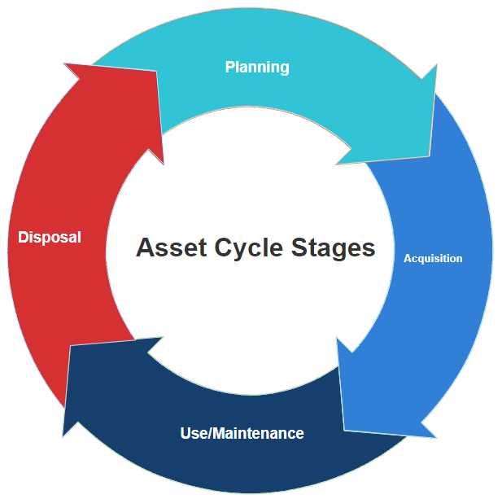
Process flow – broken into stages
Planning
Budgeting
Acquisition
Procurement process
Use/Maintenance
Record assets
Asset verification
Space data dependencies
Disposal
Notes:
Now if we paint a more colourful picture, we can break all of those activities down to these 4 stages:
Planning – where you will do the budgeting
Acquisition – the procurement process
Use & maintenance – where you now do the recording of the assets, the depreciation and the “general activities” including the asset verification.
Last stage is the disposal –
I want to use these stages to discuss a little more detail and how the system is assisting you to execute these stages…

Slide 5
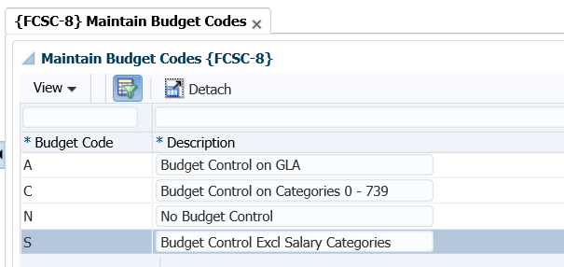
Planning
Notes:
If you process the budget – the practice is to make use of the standard categories. There are 4 system-defined categories.
A – for the GLA
C – for the CC – BUT pay attention to the account categories that are included… I will get back to this.
N – no budget
S – Per CC where you exclude the salary accounts.
You will remember that the asset categories are from 890 to 899 – that means if you want to set a budget ONLY for the purchasing of assets, you will have to
define a NEW budget code and link the account categories to that code.

Slide 6
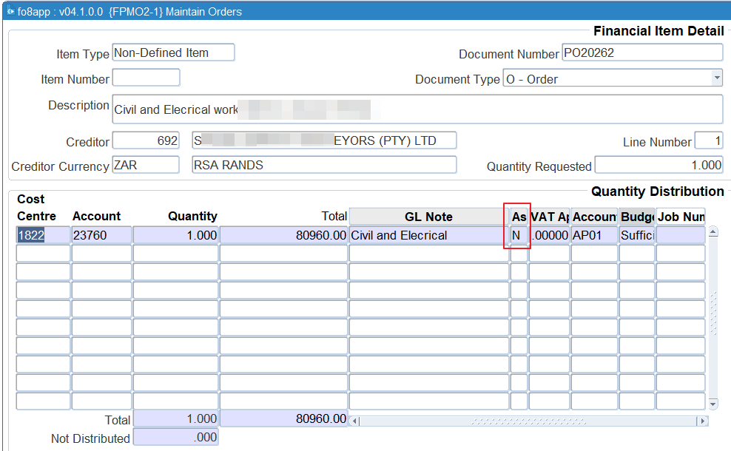
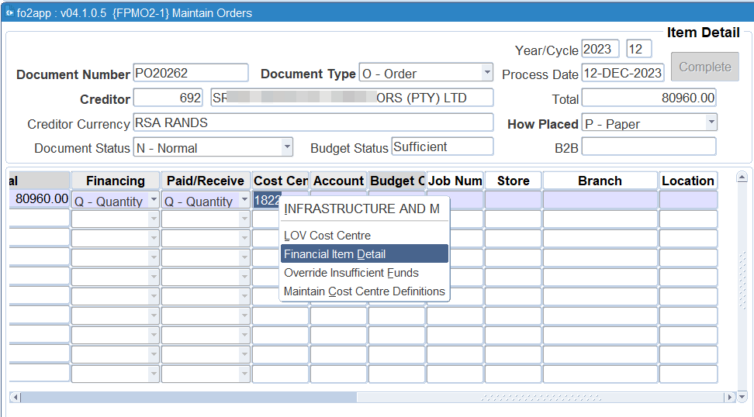
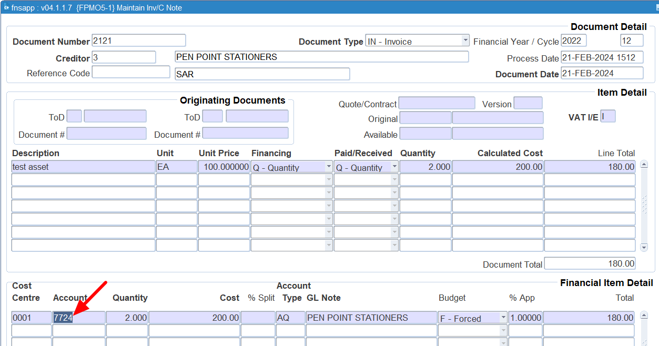
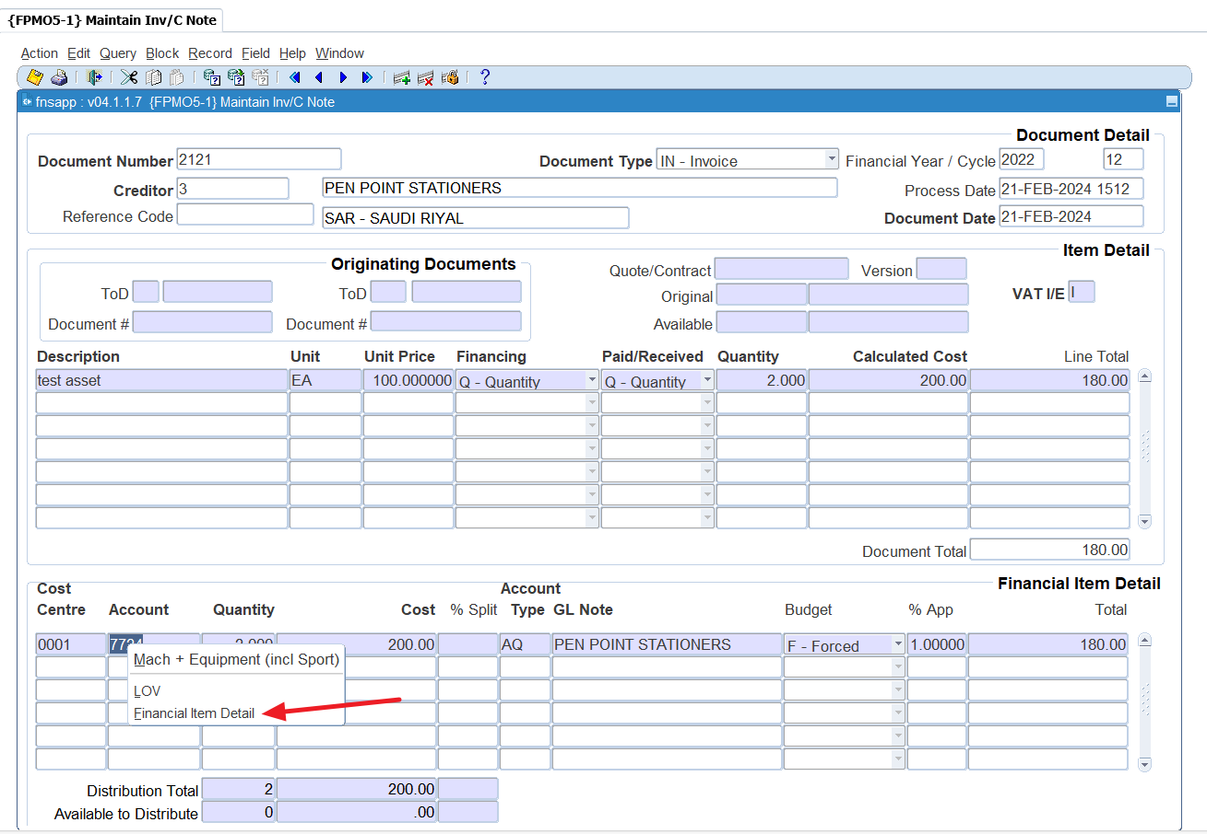
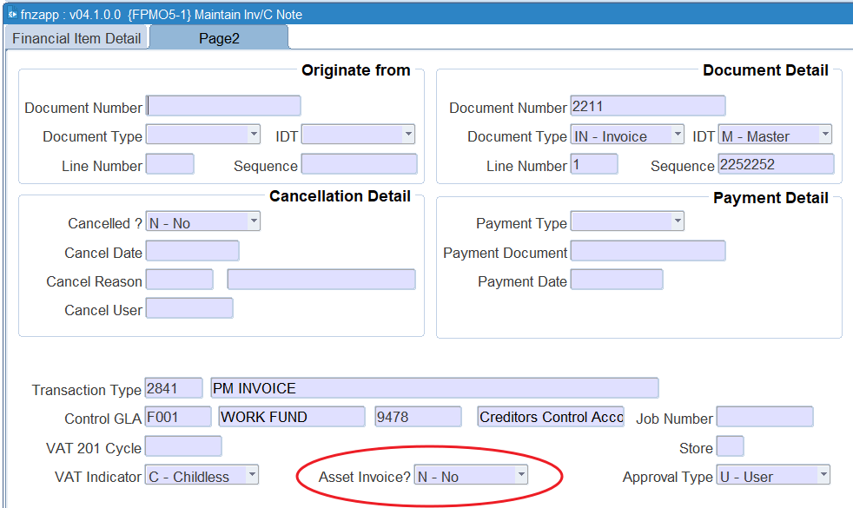
Acquisition
Notes:
When you process a request in the Finance iEnabler – you can use the asset tick box, This means it will ONLY display the asset accounts.
Where you are not using the iEnabler, processing an order – you will see when you right click on the CC definition, viewing the financial item detail, it drills down to the following field.
Where you are processing an invoice and you didn’t indicate it is an asset, remember when inserting the account. You can right-click on the account and select the financial item detail.
That will take you to the financial item detail, where you need to look at the second page where the indicator asks if it is an asset invoice.
Also remember where you are processing transactions against asset accounts the report in {FMPOR3-6} can provide the information of ONLY asset purchases – this can be used to confirm that the asset is indeed on your asset register.
This can assist the asset officer of an asset acquisition.

Slide 7
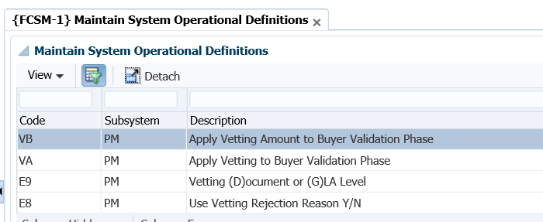
Acquisition - continue
Notes:
Are you familiar with the vetting functionality that is available in the PM system? Yes – it can help you with the assets side of things.
Here are the SOD’s relevant SHOULD you decide to utilise this.
VA and VB are the two most important ones, because.
VA will determine if vetting is used.
VB will determine when it will be used if it is based on an amount higher than a specified amount.
E8 is just an indicator that if the buyer rejects at the vetting stage, a reason will be required.
E9 determines that the amounts will be applied to Document level, which means this request, will be on the total of the document and not per GLA level (per line items).

Slide 8
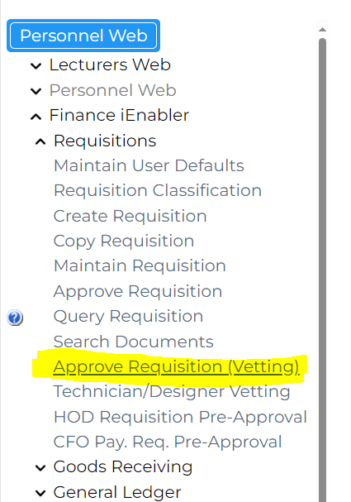
Acquisition – continue (vetting)
Notes:
The top process is the “old” way of doing the “buying” of goods.
The bottom is now including the new functionality where you utilise the vetting functionality. Remember this is NOT only for assets…
On the iEnabler there is a separate function to allow for the vetting. All of this works with restrictions.
On the iEnabler – I told you about that field – here it has an additional function, where it allows for a route to the assets office. They will get a notification that there is a purchase of an asset planned. If they don’t agree it is an asset, they can change that.
Here is the screen that the finance officer see that does the vetting. Ignore – won’t time out to alternative person.

Slide 9
Acquisition – continue (vetting)
Notes:
Let’s re-cap. Once the vetting was done, assets agree it is assets, the approvers can continue, before the order is processed.
Result is, the correct account is used, while the asset officer is aware if there are assets purchased, also not leaving out the tagging of the assets.

Slide 10
Use and Maintenance
Create assets in bulk – {AOPS-12}
Same vs. Variety
Calculation of depreciation
Reversal of depreciation
Reconciliation of assets
Updating specific fields/values?
Residual values?
https://imtech.imt.fr/en/2019/11/15/servitization-of-products-towards-a-value-creating-economy/
Notes:
We allow you to load assets in bulk… but AOPS-12 is where the assets have the same type, category and location.
We are Uploading different assets with different attributes using a CSV file. We are busy with the development of loading different assets. Please understand that this is complicated, as we need to consider a number of things. Remember we allow you to load any data in specific fields, so we need to think about the impact when other things are then done.
The recommendation is to perform depreciation monthly. I know some of you do it at the end of the year, but do it every month, when you are also reconciling the asset register with the GL.
The depreciation calculation is done on days – including the leap year day, not looking at months – Excel formulas sometimes differ.
Talking about depreciation… AGRAP-1 Reversal of Depreciation – We are in the process of making changes to the program. We write the depreciation per year and cycle on the subsystem. When we load, we should also look at the year and cycle of take on. So when we reverse if the date chosen is < or = year and cycle of take on we reverse everything and then re-calculate with our rules.
For the reconciliation - Remember that you can’t do a TT recon – you do an account recon…
For those who battle with that, We have partnered with Caseware and they have a product called IDEA. The tool allows you to analyze data from the Integrator system. We are working closely with the Caseware colleagues and we have been communicating with them on the data and understanding the relationship of data in the various tables. Please attend session 39 to see what they can also do.
Some clients have requested that they should be able to upload certain fields on AOPS e.g. person responsible, person allocated, ownership codes, Cost centre and account codes for Capital, Depreciation and Accumulated depreciation and Remarks – is this a general feeling among the colleagues here? What are the rules?
Can the system use a percentage value for residual value, instead of a number? What is the feeling?

Slide 11
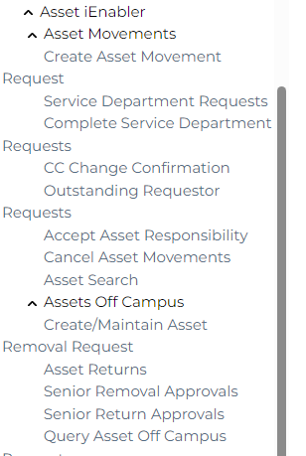
Use and Maintenance - continue
On the asset iEnabler
Movement of assets
Assets off campus
Notes:
When we look at activities for assets then we can’t exclude the movement of assets.
The asset iEnabler has the functionality to allow the internal movement of assets, not just from specific space to another one, but also between CC codes – or depatments.
as well as a request for movement off campus.
On the definition of an asset, the person allocated and the person responsible is NB here.
If nothing is allocated here, nothing will show to move, also if there is not a person responsible, know who will approve.

Slide 12
Use and Maintenance - continue
Notes:
Let’s look at the menu on AGRAP.
I spoke about the reversal of depreciation and the effort that needs to go in there.
I want to highlight some of the queries we are receiving with the help desk.
Is the UL still accurate for the assets – before the auditors find out that assets are fully depreciated.
The UL file is uploaded via the option on the menu {BATCH-26}
There are two options for the UL. One for the existing and one for the additional.
For existing UL update:
The asset can’t have depreciation values
Can’t have a recognised date.
For additional UL update:
You can’t have depreciation after the “new” start date of your new UL.
Impairment of assets and revaluations?
Revaluation of land and buildings?
What about the issue around adding values to an asset like we do every year for NMMU which is capitalizing the maintenance of buildings to a building?
Moveable and immovable assets also Land Improvements are addressed in the normal cycle of the asset process? SPCS-3 improvements
What about partial write-offs.

Slide 13
Use and Maintenance – continue {AGRAP}
Notes:
Let’s look at the following menu options:
Updating the recognised date.
Remember you can’t use the option to insert a recognition date if the asset has a date already completed. You can’t make the recognised date null with this option. This option is to help you where you did the bulk assets load and now want to insert a date. The recognised date is used for depreciation purposes.
Update purchase price.
Can only use this if there is NOT a recognised date
Shouldn’t have a UL completed.
Shouldn’t have depreciation.
Moveable and immovable assets also Land Improvements are addressed in the normal cycle of the asset process? SPCS-3 improvements
What about partial write-offs.

Slide 14
Use and Maintenance - continue
Asset survey or asset verification
Scanner vs. mobile phone application
https://ruggedsa.co.za/product/zebra-tc15-handheld-mobile-computer/
Notes:
Asset verification tool with scanner and ability to indicate missing assets and update the condition code of assets with the scanner and software. – we have been reaching out to providers. I can explain the use of an app vs. a scanner.
How are you currently performing the survey?
How often are you doing this?
How long does it take to execute?
Are you using a 3rd party company to do this?
How do you manage the assets that are taken off campus?

Slide 15
Use and Maintenance - continue
The functionality we want for the app can be listed as follows:
Link the geolocation to the asset when scanning.
Take a picture of the asset.
Change the condition of the asset.
Add comments to the asset.
https://ruggedsa.co.za/product/zebra-tc15-handheld-mobile-computer/
https://www.erpfixers.com/blog/new-functionality-available-with-sap-s4hana-finance
Notes:
What do we want to give you – in terms of a “scanner”
The company Winjit has done some smart campus solutions…

Slide 16
Disposal
Bulk assets write-off – {AMNT-9}, {AMNT-10}.
https://ruggedsa.co.za/product/zebra-tc15-handheld-mobile-computer/
Notes:
Bulk assets write-off. Remember that there are prerequisites. TT needs to be defined and linked to the event ‘BW’. Make sure about the posting indicator on the TT definition.
BUT – first, upload the file in {AMNT-10}. Just make sure the settings on your PC are doing a comma-delimited file and NOT semicolon values. Important to look at the processing rules in the manual – or online help.

Slide 17
https://unsplash.com/photos/question-mark-neon-signage-8xAA0f9yQnE

